Slide 1
ENTREPRENEURSHIP and
Business Management
Lecture No: 8

Slide 2
International Joint Venture

Slide 3

The entrepreneur attempting to “go international” should also consider an international joint venture. Here, two firms get together and form a third company in which they share the equity.
Notes:
3
3

Slide 4
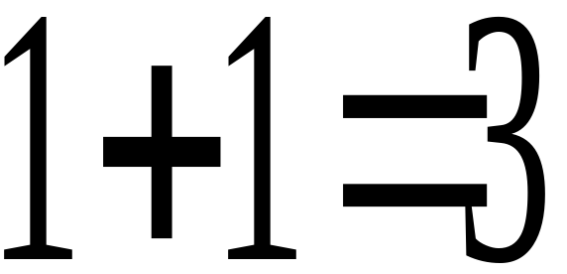

The joint venture should have synergy.
Synergy means that the whole is greater than the sum of its parts so that:
Notes:
4
4

Slide 5
Strategic Issues to Consider

Slide 6

Strategic Issues to Consider:
Is rapid entry into the market needed?
Will joint venture result in obtaining a competitive advantage?
The allocation of responsibility between the U.S. and the foreign operation.
Would the joint venture lower the chances of expropriation (mining ventures)?
What’s the degree of standardization
possible?
Notes:
5
5

Slide 7
Options for entering international markets

Slide 8

Options for entering international markets.
Indirect exporting involves using a foreign purchaser in a local market.
Direct exporting uses independent distributors.
Notes:
6
6

Slide 9
Entrepreneurial Partnering

Slide 10


Consider ‘entrepreneurial partnering’ to enter international market. Local partner has better understanding of the nature of entrepreneurship in that country. Suggested targeted areas:
Europe
The Far East
Controlled and transition economies (China, Latvia, Hungary).

Slide 11
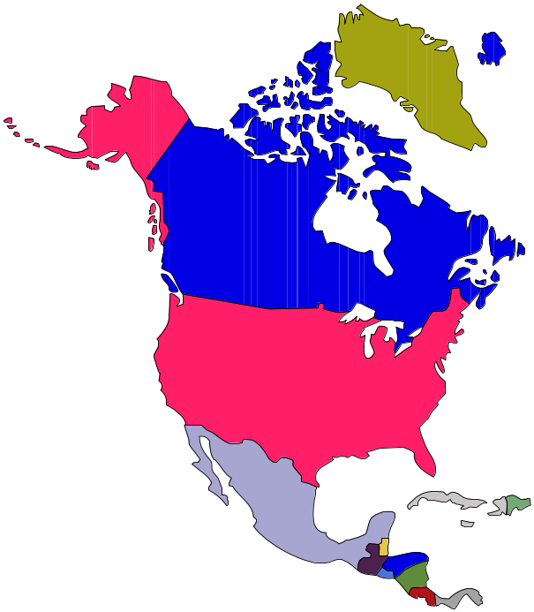
Barriers to International Trade
GATT (the General Agreement on Tariffs and Trade) seeks to help overcome barriers.
Some countries (Japan) allegedly present barriers due to their complicated distribution system.
FTA’s (free trade agreements)
such as NAFTA reduce barriers
and encourage investment
between countries (in this case the U.S., Canada and Mexico.)
Notes:
7
7

Slide 12
Sources of ideas for new ventures

Slide 13

Sources of ideas for new ventures:
Consumers. Determine their wants/needs.
Existing companies. See if there are ways to improve upon products and services in the market.
Distribution channels. Elicit suggestions from channel members.
The Federal Government. Check the Government’s Patent Office files.
R.&D. Conduct your own research & development.
Notes:
2

